Slide 1
Welcome to the Mercy Volunteer Team! General Volunteer Orientation
Jenna Maxson
Volunteer Services Manager
319-339-3659
Jenna.maxson@mercyic.org
6/2020

Slide 2
Agenda
Page 3: Volunteer Services Contact Information
Page 4-5: Volunteer Service Descriptions
Page 6: Requirements
Page 7-9: History, Mission and Values
Page 10: EMTALA
Page 11: Dress Code
Page 12-21: Parking, Screening, Attendance and Hours Tracking
Page 22-24: Confidentiality
Page 25-39: Safety and Security
Page 40: Abuse Reporting
Page 41-45: Customer Service, Diversity and Equality
Page 46-47: Vocera Use
Page 48-49: Volunteer Benefits
Page 50-52: Guild Services including Guest Lodging and Gift Shop
Page 54-60: Infection Control
Page: 61 Volunteer Policies / Mercy Central

Slide 3
Mercy Volunteer Program
The Volunteer Office is located on 2nd floor of Mercy North.
500 E Market St. Iowa City, IA 52245
Office hours are from 8 a.m. – 4:30 p.m. Monday - Friday.
Closed on holidays.
If you need to reach the Volunteer Services Manager, please call 319-339-3659 or email jenna.maxson@mercyic.org.
Communications preferred by email or phone at this time.

Slide 4
Volunteer Areas
Liaison: Greet Mercy colleagues as they enter the building, answer general hospital questions and provide directions. High customer service skills required.
Gift Shop: Promote sales, collect payment via credit card, cash or employee deduct for Gift Shop purchases, gift wrap and/or bag purchased items for customers, check inventory, tag merchandise and organize displays. High customer service skills required.
Clerical: Greet Mercy colleagues, assist with filing, labeling and alphabetizing of folders and files. Package fall risk kits, put together patient packets, organize surgery folders and other clerical tasks as assigned. There is little to no contact with patients and visitors required for this position. Various departments are available for clerical volunteer assistance.
SHIIP: Senior Health Insurance Program. Provide insurance counseling to clients after Des Moines SHIIP required initial and ongoing training.
Mercy Guild: Ask the Volunteer Manager how you can play a part on our Mercy Guild! The Guild’s purposes is to raise funds for the hospital and provide services that enhance colleague experience.
Guild membership is $10 / year or $100 / lifetime.
Several volunteer areas previous to Covid 19 have been discontinued at this time and new volunteer opportunity obtained.

Slide 5
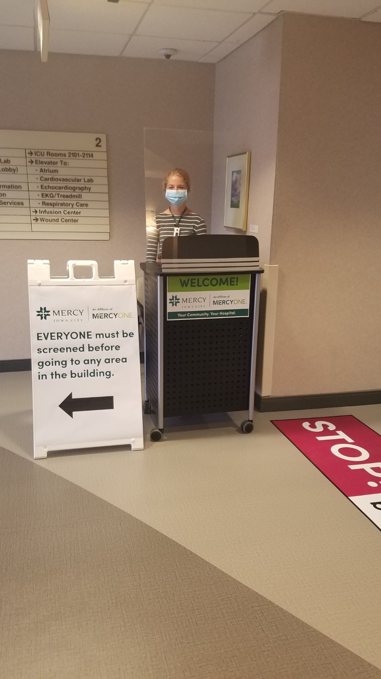
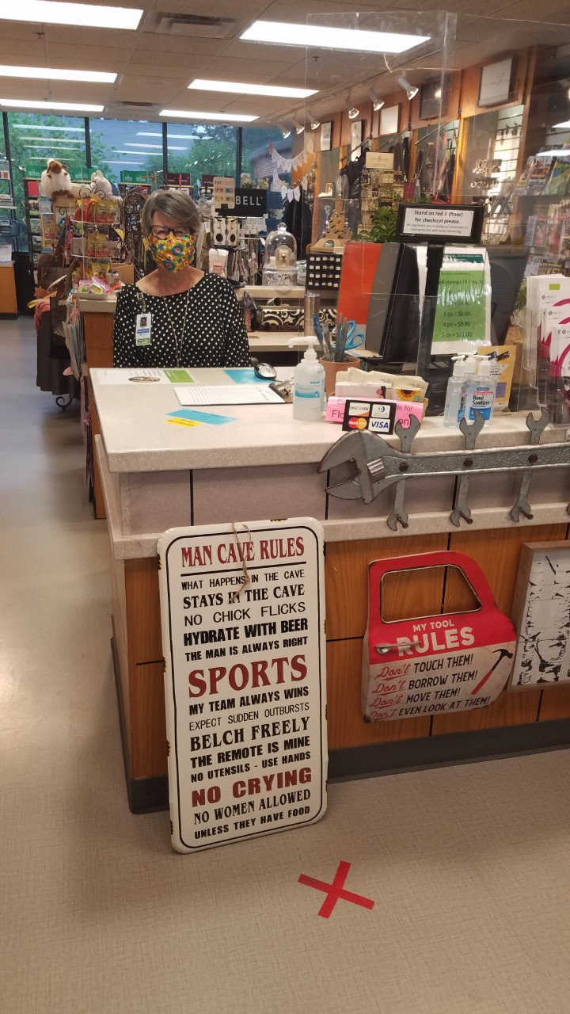

Slide 6
Volunteer Requirements
Application Submission
Interview
Acceptable criminal, national and a dependent adult abuse background checks
Completion of Health History form and immunizations
Completion of Commitment and Confidentiality Agreement
Completion of volunteer Power Point orientation and sign off
Service Description signature after service area training
Covid 19 Consent form signature
Photo Consent form signature
Follow all Volunteer Policies and Procedures including dress code
Positive attitude and reliability

Slide 7
Mercy Iowa City History and Mission
Mercy was founded in 1873 and has been an integral part of the Johnson County community serving patients from a 10 county area.We are a private, not-for-profit , community, Catholic hospital providing services to people of all religious affiliations.
Mercy’s mission is to heal and comfort the sick and work to improve the health of our community in the spirit of Jesus Christ and the Catholic tradition of the Sisters of Mercy.

Slide 8
Mercy Iowa City Values
Respect: treating each person with dignity and honoring the sacredness of human life
Excellence: providing personalized, quality care
Compassion: showing empathy and care for the sick and vulnerable
Stewardship: using resources responsibly
Collaboration: working together for the common good of the community

Slide 9
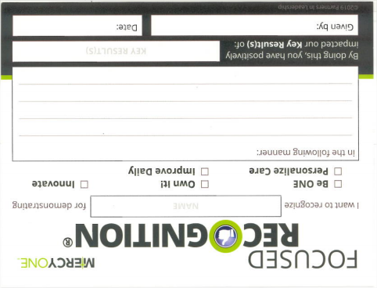
MercyOne Focused Recognition Cards!
MercyOne focuses on frequent recognition of demonstrating the following: “Be ONE” (teamwork), “Own It!” (owning your actions), “Innovate” (creative and inspirational thinking), “Personalized Care” (individualized service and care), and “Improve Daily” (constant improvement).
Key Results:
Consumer Experience
Team Engagement
Quality
Sustainable Growth and Efficiency
Ambulatory Growth

Slide 10
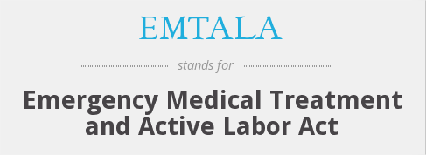
EMTALA
It is the law!
“If you have a medical emergency or are in labor, you have the right to receive, within the capabilities of Mercy Hospital, an appropriate medical examination screening, and necessary stabilization treatment including treatment for an unborn child.”
Volunteers, it is important that you know - Everyone, regardless of insurance standing or financial ability to pay for the service will receive the above treatment as needed.

Slide 11
Volunteer Dress Code Policy A-10 Mercy Central
Mercy Iowa City Volunteers Will:
Wear their Volunteer ID badge, issued by Mercy Iowa City, above the waist and forward facing.
Wear a face mask. Masks are provided by Mercy Iowa City as needed.
Wear a face shield as deemed required per specific volunteer areas.
Wear closed toed shoes if volunteering primarily in a patient area.
Wear business casual attire. No blue jeans or workout material clothing.
Not wear clothing, symbols or other that may be deemed offensive such as vulgar language or graphics.
Volunteers are required to practice quality personal hygiene including wearing clean clothing.
If the appropriateness of volunteer attire and/or overall appearance is in question it will be deemed appropriate or not by the Volunteer Services Manager and/or Human Resources Director. If deemed not appropriate, volunteers may be asked to review this policy and end their shift for that day; or discontinue volunteer services permanently.
Mercy Iowa City is not responsible for lost, stolen or broken items of clothing or accessories during volunteer shifts. Volunteers are encouraged to not bring in items high in value during their shift such as earrings, purses or other.
Youth volunteers (14-17 years of age) will wear a royal blue polo identifying them as a youth volunteer.
All volunteers must don a mask (provided by Mercy Iowa City if you do not already have one) during their entire volunteer shift as of 6/2020.

Slide 12
Volunteer Parking
Parking – Mercy volunteers and employees share parking spots on a first come, first serve basis. Parking is free of charge.
Lower level of the Medical Plaza (enter off Van Buren St.)
Mercy flat lot off Market St. or alley off N. Dodge St. and Johnson St.
Mercy employee and volunteer ramp (upper level of ramp access off Bloomington St. connected to flat lot and lower / ground entrance off Johnson St.). *Upper level suggested as closest to Volunteer Screening Station in the Mercy Guild room level 2 - North.
See next slide for map.
Volunteer parking NOT permitted at parking entrance off Johnson St. that leads to the ramp connecting to the Mercy skywalk. This parking is for patients and visitors only.

Slide 13
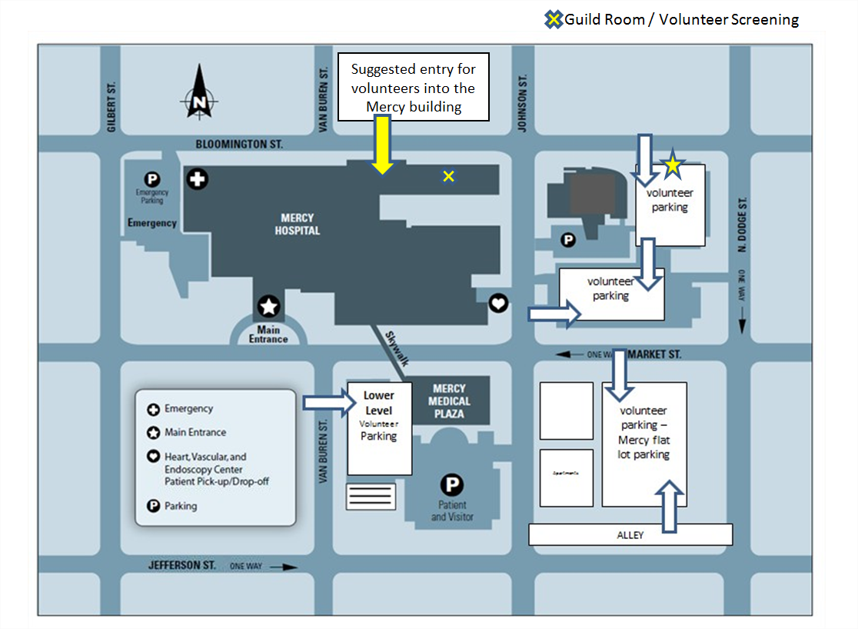

Slide 14
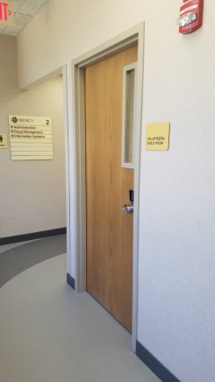
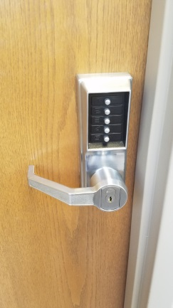
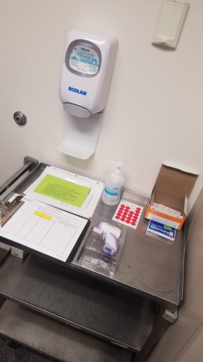
Volunteer Required Screening
When you arrive, you must check your temperature and answer CDC recommended health questions prior to beginning your volunteer shift. The volunteer screening station is located in the Mercy Guild room – level 2, north. You will receive the door code from Volunteer Manager before your first day. If you have a fever or any symptoms you must exit the building immediately and contact the Volunteer Manager via email or phone to inform them.

Slide 15
Attendance
Please be punctual and conscientious in the fulfillment of your volunteer assignment.
Consistent and reliable attendance is expected.
Volunteers who do not come three consecutive times without notifying the Volunteer Services Manager of their absence will be considered terminated and their position may be filled by another volunteer. If your assigned shift is missed frequently, even with communication, discussion of a shift time change, department change, or termination will be discussed.

Slide 16
Volunteer Hours and Tracking
All volunteers, whether they are at Mercy Hospital or volunteering on behalf of Mercy outside the building should record their volunteer hours. If you do not clock in, the Volunteer Services Manager will not know you are still an active volunteer.
In-house volunteers should sign-in and out via the electronic sign in system. Sign in stations are located:
In the Guild Room – Mercy North, level 2

Slide 17
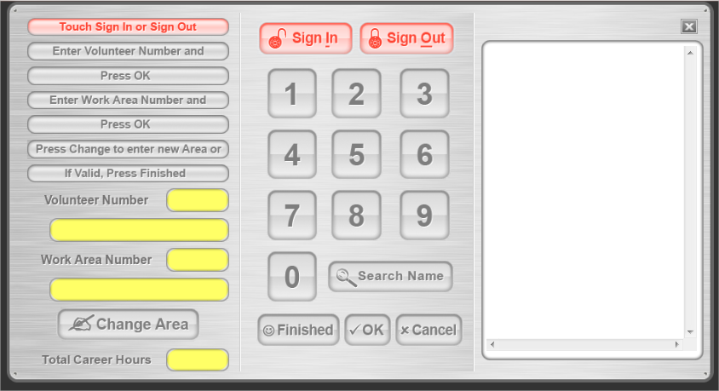
Voltraks Tracking Program Volunteer Sign-in Screen

Slide 18
Voltraks Tracking Program How to sign in and out
To sign in:
Click the “Sign-In” button at the top of the page.
Enter your volunteer number
Enter your work area number, click ok.
Click the “Finished” button at the bottom of the page.
To sign out:
Click the “Sign-Out” button at the top of the page.
Enter your volunteer number, click okay.
Click the “Finished” button at the bottom of the page.

Slide 19
Voltraks Tracking Program If Voltraks or computers are not working…
If the Voltraks
program or the
sign in computer is
not working, paper
tracking is
provided at each
sign in computer as
well. Please log your
hours.

Slide 20
Absence
To report a volunteer absence please call the Volunteer Services office at 319-339-3659 or email the Volunteer Services Manager.
Always provide your name, service area and the time you were to volunteer. It is important we understand who you are and what shift you are calling in absent for.

Slide 21
Volunteer Lockers
Lockers – Volunteers are encouraged to lock up their personal belongs each time you volunteers. Lockers are available on a short-term basis in the Guild/Volunteer Room M-F 8:00 a.m. – 4:30 p.m. Put your valuables in the locker and take the key with you. When you are ready to go, please remove your items and leave the key in the lock.
Items of high value are encouraged to NOT be worn while volunteering.

Slide 22
Confidentiality
Patients have the right to privacy while they are in Mercy’s care.
It is the responsibility of every person at Mercy, including volunteers, to keep patient information confidential.
A breach of confidentiality is serious and may result in termination of your volunteer service and/or legal action.
Maintaining confidentiality creates an atmosphere of trust in which a patient is more likely to share information vital to his or her health care.
Do not share any information you learn about a patient including diagnosis, conditions or treatment.
Never question a patient or staff about a patient’s illness.
Do your part to maintain a patient’s confidentiality.

Slide 23
Confidentiality continued …
Never talk about a patient in a public area, even if the patient is a family member or friend.
Never talk about a patient unless to a medical staff on the unit the patient is in, and in regards to the patient’s needs.
If you have access to the patient locator list on the computer never look through the list to see if there is someone you know on the list and never leave your computer screen unattended.

Slide 24
What is HIPAA?
HIPAA stands for Health Insurance Portability and Accountability Act.
It is a federal regulation that protects a patient’s personal and health information.
Misusing patient health information has serious penalties.
If a volunteer would be reported for a breach of confidentiality, the volunteer could be subject to criminal penalties and fines and may be terminated from their volunteer service.

Slide 25
Safety and Security
All volunteers must follow department safety rules and use good judgment and common sense while volunteering.
Potential hazards, suspicious or questionable situations and threats, as well as other safety and security issues should be reported immediately.
Safety and Security officers are on duty 24/7. Please call them if you are in need of assistance with a safety issue.

Slide 26
Safety and Security continued …
The Mercy Hospital Security office telephone is 319-339-3694. The cell phone number from inside the hospital is 9-319-530-7400.
To report an internal emergency, call 3911 and describe the emergency, and location. You will never get in trouble for calling 3911 if you think there is an emergency, even if the situation is deemed not an emergency later on.

Slide 27
Safety and Security Emergency Codes
All Mercy emergency codes will be announced using the overhead paging system.
All emergency codes start with the words “Attention Please.” You will then hear the name of the alert, and the location.
If you hear the words “Attention Please,” listen carefully so you know what to do.

Slide 28
Safety and Security Emergency Codes - Fire
Fire or Smoke –The page will be “Attention Please, Fire Alarm, location of fire.”
Stay away from the location of the fire.
Fire doors will close but not lock.
Do not use the elevators.
Evacuate horizontally.
Familiarize yourself with the location of the fire extinguishers in your work area.
If you need to use a fire extinguisher, remember PASS:
Pull the pin
Aim the extinguisher at the base of the fire
Squeeze the handle
Sweep from side to side

Slide 29
Safety and Security Emergency Codes – Tornado
Tornado Warning / Watch - You will hear an overhead page that says “Attention Please, the National Weather Service has issued a tornado warning / watch for the Johnson County area.
Do not leave the building. Take shelter in the inside corridors.
Volunteers in the Gift Shop or Visitor Screening will need to evacuate the area and move to the Radiology area.
Volunteers in Guest Lodging will need to go door to door to alert the guests to take shelter in the stairwell or other safe place.
Volunteers need to reference posted Tornado safety signs posted in the building. Stay away from windows / glass / sharp objects.

Slide 30
Safety and Security Emergency Codes – Emergency Operations
Emergency Operations - The page would be “Attention Please, Emergency Operations Team”
This code indicates that something has happened in our community and we have the potential to get a large number of patients in a short period of time.
Stay in your area if you are needed in your area. If not needed, report to the labor pool in the Community Relations office.

Slide 31
Safety and Security Emergency Codes – Medical Emergency
Medical Emergency - The page would be “Attention Please, medical emergency, location.”
Volunteers do not have a direct role in this emergency. It typically indicates a patient or visitors is suspected of having cardiac and/or respiratory arrest.
Watch out for staff who are running to assist this patient.
Move obstacles such as wheelchairs or carts out of the way of running personnel.

Slide 32
Safety and Security Emergency Codes – Aggressive Person
Aggressive Person - The page would be “Attention please, Aggressive Person, location.”
Stay away from this area.
If the incident is occurring in your area, close patient doors, and move to a safe place away from the incident.
Do not become involved in this situation.

Slide 33
Safety and Security Emergency Codes – Active Violence
Active Violence – The page would be “Attention please, Active Violence, location.”
Person using or brandishing a weapon, ALICE (Alert, Lockdown, Inform, Counter, Evacuate) can be used. Volunteers are not required to attend ALICE training, but they are offered, free of charge, and count towards volunteer hours.

Slide 34
Safety and Security Emergency Code – Missing Child
Infant or Child Abduction – “Attention Please, missing child, and location.” Be aware of anyone suspicious. This could include a person who is carrying a child or large bag big enough to conceal an infant, or anyone walking quickly or running towards an exit.
Call the hospital operator (“0”) to report what you are witnessing and the location of a suspicious person right away.
If possible, monitor a hallway or stairwell until the
“Missing Child, All Clear” is called.
If near an exit, stand by the exit and stop or delay anyone from leaving.
Be a good witness. Should you see someone who looks suspicious, note the person’s sex, height, weight, identifying characteristics and clothing.

Slide 35
Safety and Security Emergency Code – Missing Patient
Adult Patient Missing – “Attention please, missing patient, location and description of the patient.”
Check your volunteer area, hallways, restrooms, etc. for the patient. If you believe you have found the missing patient call x3911 and report.
Note: Patients who are deemed moderate to high risk of elopement will be given an aqua wrist band. If you ever see a patient with an aqua wrist band, notify the Operator right away (dial “O”). Do not leave the patient unattended.

Slide 36
Safety and Security Fall Risk Patients – Patients at risk of falling
If a patient is deemed a moderate to high risk for falling (due to medical condition, current medications, etc.) they will be given a yellow wrist band and yellow socks.
For patient safety, if you see a patient with a yellow wrist band or yellow socks (or any person who appears off-steady), dial the Operator (“0”) right away. Do not leave the person unattended.

Slide 37
Safety and Security Bomb Threat
Bomb Threat. No code or announcement.
Remain calm and try to note as much information as possible.
Note the caller’s voice, background sounds, etc.
Ask when the bomb is going to explode, where it is, etc.
Note the time the call was received, the length of the call or any other helpful information.
Immediately report the call a Mercy Security officer x3911

Slide 38
Safety and Security Wheelchair Safety
Volunteers may NOT transport patients in wheelchairs. Volunteers should help to monitor the following safety rules. If a patient needs assistance, a nursing staff member or Transporter need to be notified.
Always be sure the brakes are locked when monitoring someone getting in or out of a wheelchair.
When getting into the wheelchair, the footrest should be folded up. Never allow a person to step on the footrest. The feet of the person being escorted should be ON the footrests during transport.
After the person is seated, fold the footrest down and adjust as necessary.

Slide 39
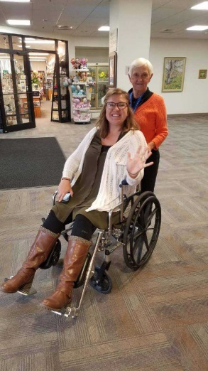
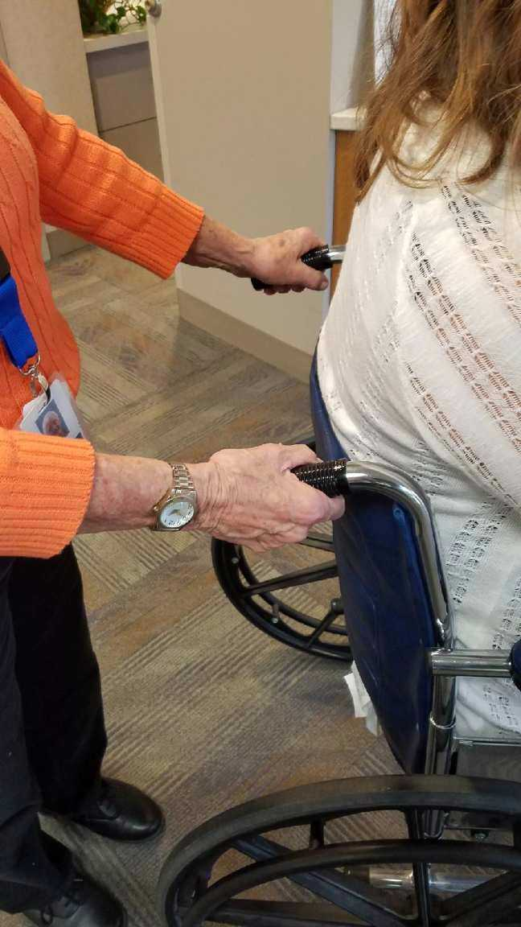
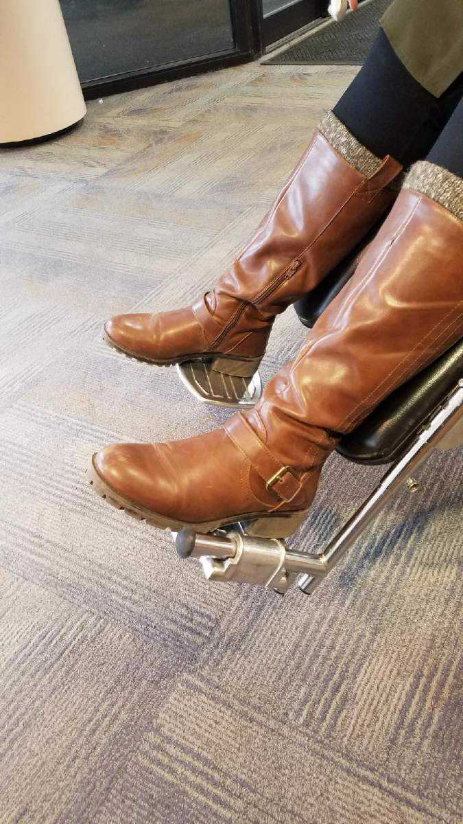
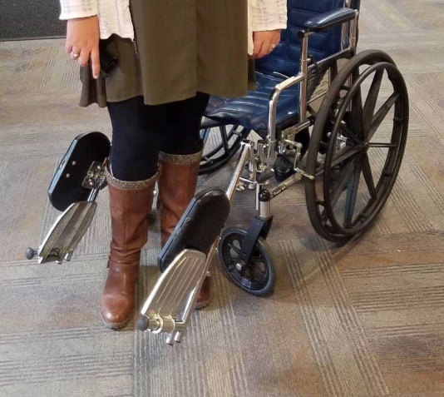
Safety and Security Wheelchair Check Points
* Feet in footrests during transport * Both hands to push the patient * Brakes on while patient is getting in and out * Footrests up while patient is getting in and out

Slide 40
Reporting Abuse and/or Harassment
Mercy employees and volunteers are mandatory reporters of abuse. If you witness, or have a feeling abuse (financial, physical or mental) has or is taking place to a Mercy patient, employee, volunteer, or visitor report it to the Manager, or Assistant Manager on the volunteer unit you are volunteering on immediately and also notify the Volunteer Services Manager as soon as possible. If a Manager or Assistant Manager is not available, please report to Human Resources (level 1).
Mercy holds a zero tolerance policy for abuse and harassment of any kind.

Slide 41
Customer Service
At Mercy, we are firmly committed to a culture of service excellence by providing the highest quality of service, care, compassion and courtesy. At Mercy we treat everyone equally regardless of age, sex, ethnicity or other.
Always:
Smile and make eye contact.
Be focused on the person you are working with.
Be courteous.
Use a friendly and helpful tone of voice.
Treat everyone with respect and dignity.
Respect a patient’s privacy.
Do not enter a room is the door is closed. If you have an item to deliver, take it to the nurse’s station and let them know why you are leaving it there. If the door is open you may enter the room. However:
Always knock before entering the room, even if the door is open.
Pause for a moment and then enter the room and state who you are, and why you are there.

Slide 42
Customer Service continued … Helpful, friendly language
DON’T SAY “I don’t know” DO SAY “Let me find that out for you.”
DON’T SAY “It isn’t my fault it is taking so long.” DO SAY “I apologize for the wait, let me get an update on estimated wait time for you.”
DON’T SAY “So-and-so should have done this already.” DO SAY “Let me get this taken care of for you.”
Customer Service continued … Reporting abuse
If you witness, are informed of or have a feeling a patient at the hospital might be being abused physically, mentally or financially report the situation to an employee on that unit, preferably the Nurse Manager or Assistant Nurse Manager right away. Human Resources or the Volunteer Services Manager are options as well if there is not an available employee on the unit.

Slide 43
Customer Service Cell phone, drug / tobacco use
Turn your cell phone off or put it on the silent mode. If you must use your personal phone, please excuse yourself from your work area and go to a private area to talk. Do not take pictures while you are
volunteering at Mercy Hospital.
Volunteers must refrain from the consumption of alcohol and or recreational drugs. Any indication of use prior to coming to the hospital or during your volunteer shift could result in termination.
Mercy Hospital is a smoke free and tobacco free
zone. Clothing must smell smoke free while volunteering.

Slide 44
Empathy and Understanding
It is key to ensure empathy and understanding of the struggles and stress our patients and visitors might be going through.
… How will I pay for all these bills?
… What tests will they have to do?
… How long is this going to take?
… Is anyone feeding my dog?
… What is wrong with me now?
… How do I tell my kids?
Please view the below video before continuing.
https://www.youtube.com/watch?v=cDDWvj_q-o8

Slide 45
Diversity and Equality
Diversity means understanding that each individual is unique and also recognizing our individual differences. The differences can be (but are not limited to) race, ethnicity, gender, sexual orientation, socio-economic status, age, physical abilities, religious beliefs, political beliefs or other ideologies. At Mercy Iowa City we value diversity and uphold equality. Equality, by definition, meaning the state of being equal, especially in status, rights and opportunity.
We treat EVERYONE with respect, dignity and quality care.
Failure to do so will result in termination of volunteer status.

Slide 46
Professional Liaison Volunteers - VOCERA
Our Professional Liaison Volunteers (and select others) will utilize a vocera for communication. It is important that ALL volunteers know that when talking on a vocera patient confidentiality must be maintained.
If you will use a vocera, you will be shown how to sign in using your name, and communicate appropriately during your unit specific orientation.

Slide 47
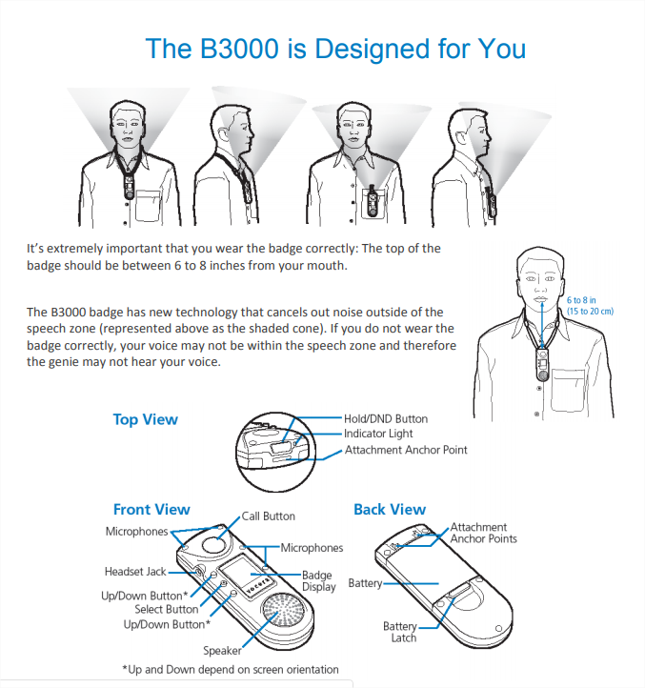
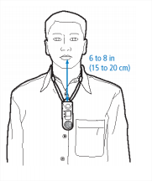
Vocera Use:

Slide 48
Volunteer Benefits
Cafeteria discount of 20% on volunteer shift days. You must show your volunteer badge to receive the discount.
Personal letters of recommendation may be requested for those volunteers that contribute 50 hours or more of service.
Record of hours served at any hour amount.
Knowing the volunteer service you are providing is VALUED assistance to Mercy Hospital. Thank you!

Slide 49
“Volunteers don’t get paid; Not because they are worthless, but because they are priceless.” – Sherry Anderson
THANK YOU FOR BEING A MERCY VOLUNTEER!

Slide 50
Mercy Guild
The Mercy Guild is a volunteer group that raises funds to donate to the Mercy Foundation with the goal of purchasing items for the hospital that assist in overall patient satisfaction and care.
The Guild’s fund-raising services are the:
Mercy Gift Shop
Guest Lodging Service
Vending Service and more
Guild Membership is $10 per year or $100 for a lifetime. Membership entitles you to:
A 20% discount in the Gift Shop on the days you volunteer.
Special recognition awards for service hours
An invitation to attend monthly Guild Board meetings
An opportunity to serve in a leadership capacity – great for resumes and college referrals!
If you are interested in joining contact the Volunteer Services Manager.

Slide 51
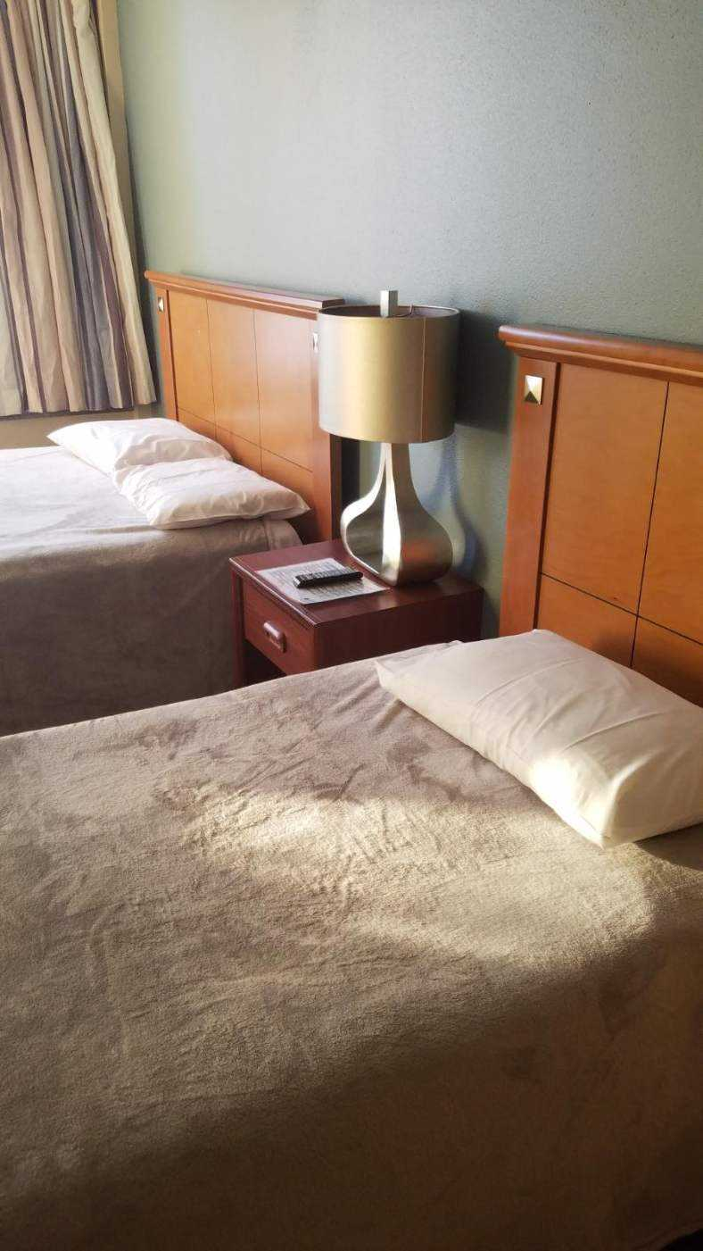
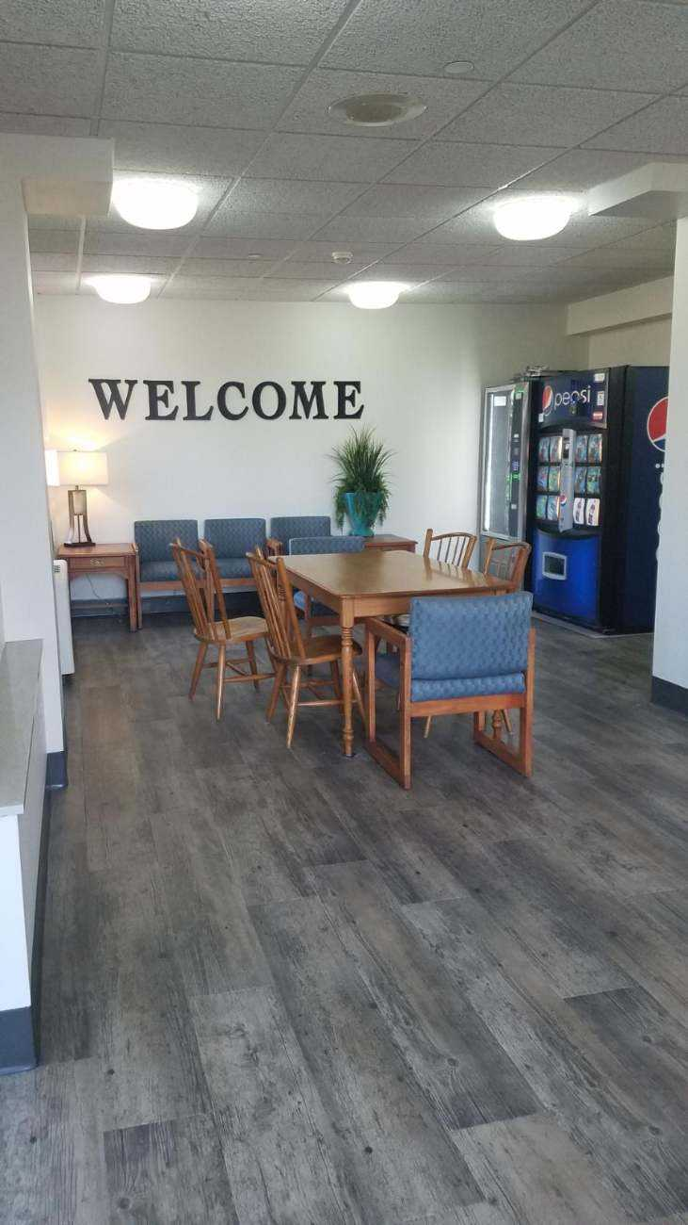
Mercy Guest Lodging
Mercy Guest Lodging is located on level 3 – north.
Rooms are $35 per night for loved ones of patients at Mercy, or patients coming in the night before an early
appointment, procedure or operation.
Guests must be 100%
independent.
No meal service, patient
transport or nursing care
provided in Guest Lodging.
Contact the Volunteer Services Manager to make a reservation.

Slide 52
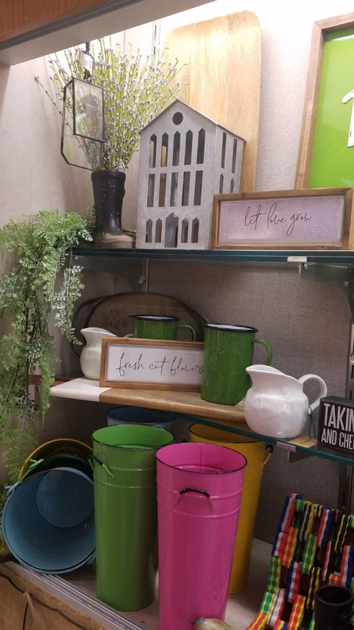
Gift Shop
The Mercy Gift Shop is located on level 2 by the main entrance off Market St. Hours of operation are posted on the Mercy website as well as the Gift Shop door.
All profits from the Mercy Gift Shop benefit the Mercy Guild.
Special sales are posted on the Mercy website and
in the Gift Shop.
The Gift Shop sells stamps, movie tickets, candy,
magazines, jewelry, cards, flowers, season décor,
baby-mother items, clothing, Hawkeye gear and more.

Slide 53
Do you have questions?
If at any point in time you have questions, or are unsure in regards to a task you have been asked to complete, do not complete the task until you have received clarity / further training from the Volunteer Manager.
Remember x3911 for emergency situations.
Safety is always first!

Slide 54
Infection Prevention Mercy Volunteers

Slide 55
Hand Hygiene (HH)
Hand hygiene is the single most important action you can take to prevent the spread of infection.
Mercy follows CDC guidelines for HH
Wash in, wash out of EVERY patient room, EVERY time.
Soap and Water when:
Hands visibly soiled
Before Eating
After using the restroom
Working with a patient with a diarrheal illness
Alcohol Based Rubs: All other occasions

Slide 56
HH Technique
Alcohol-based hand rub:
Apply product to palm of one hand
Rub hands together, covering all surfaces
Rub until dry – do not towel off excess
Soap and water:
Wet hands first with water
Apply enough product to cover the hand
Rub hands together vigorously for at least 20 seconds, covering all surfaces
Rinse hands with water
Dry thoroughly with a disposable towel
Use towel to turn off the faucet and open the door

Slide 57
Standard Precautions
Use with all patients and their environment, all the time.
Assume every person is potentially infected or colonized with an organism that could be transmitted in the healthcare setting.
Includes:
Hand Hygiene
Personal Protective Equipment (PPE)
Respiratory Hygiene/Cough Etiquette = Mask
Care of the Environment

Slide 58
Isolation Rooms – Do NOT Enter
If a patient is in an Isolation room (noted on the outside of the patient’s door), then volunteers should NOT enter the room. Items for the patient can be left at the Nurses Station.
Isolations rooms can be identified by the caddy outside the patient’s room door.

Slide 59
Exposure Procedure
Volunteers are not to use or be near equipment that could lead to a needle stick, sharp injury, or any other type of blood borne pathogen exposure. However, if you exposed, you will immediately fill out a First Report of Injury (FROI) available on Mercy Central; contact Human Resources, the Volunteer Services Manager or ADON right away and report the incident.
* Turn the FROI into Human Resources.
* Follow-up care will be provided if needed.

Slide 60
PPE or Personal Protective Equipment
Includes gloves, gowns, masks, goggles, shoe covers, and respirators.
Volunteer should not be in contact with any direct bodily fluids or where splash might occur.
Volunteers should never enter a situation where a respirator is necessary.
If PPE outside of masks and gloves are required for a task you are being asked to complete, STOP and confirm the task is appropriate with the Volunteer Services Manager before moving forward.

Slide 61
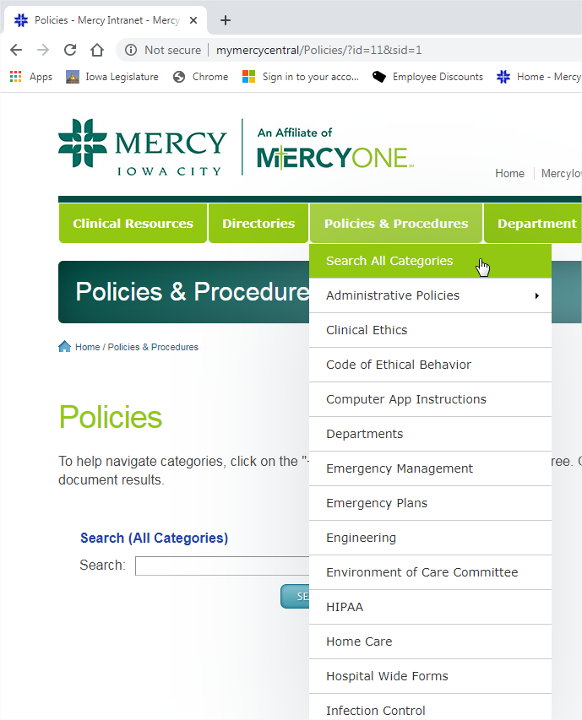
Volunteer Policies – Mercy Central http://mymercycentral/
Policies and Procedures
“Search All Categories”
A-1: Volunteer Services Scope of Services
A-2: Volunteer Services Purpose and Procedures
A-3: Selection and Placement of Volunteers
A-4: Volunteer Services rules of Conduct
A-5: Volunteer Competency Verification
A-6: Volunteer Benefits
A-7: Volunteer Services and Mercy Guild
A-8: Volunteer Grievance Procedure
A-9: Volunteer Background Checks
A-10: Volunteer Dress Code
B-1: Mercy Guild Membership
B-2: Mercy Guild Benefits
B-3: Mercy Guild Services Awards
C-1: Guest Lodging Policies

Slide 62
Our new Covid world …
Again, Volunteers are REQUIRED to wear a face mask during their volunteer shift.

Slide 63
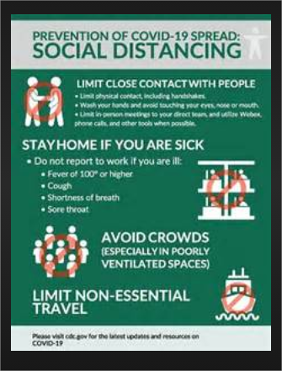
Our new Covid world …
Practice social distancing.

Slide 64
Our new Covid world …
Covid or not, wash your hands!

Slide 65
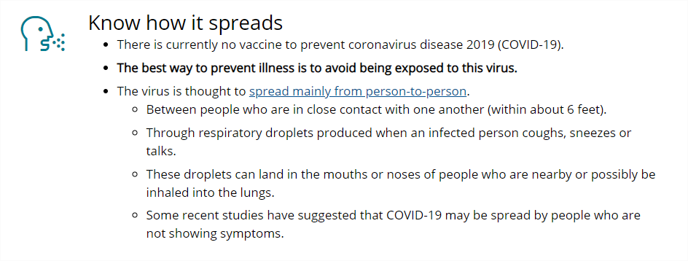
Our new Covid world …
Know your risk.
To see up-to-date information regard who is higher risk for getting seriously ill or worse if Covid 19 is contracted visit the Center for Disease Control and Prevention CDC website at https://www.cdc.gov/

Slide 66
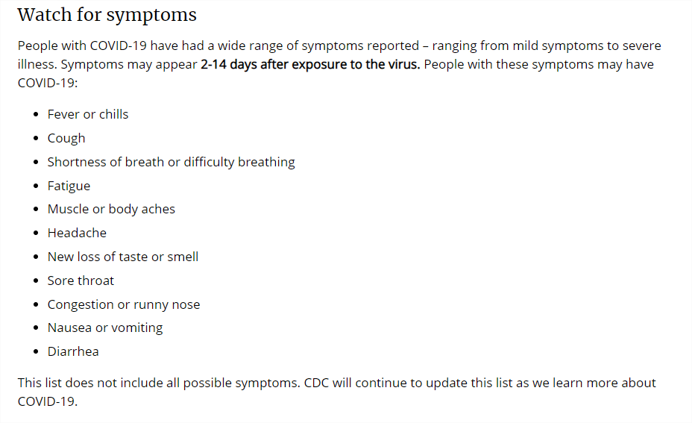
Our new Covid world … CDC information as of 9/2020

Slide 67
Our new Covid world …
Mercy volunteers are required to complete a screening process before beginning each volunteer shift. They are also required to sign a Covid 19 release form before being accepted to volunteer at Mercy Iowa City.
If you have any symptoms, stay home and contact the Volunteer Services Manager via email or phone.
If you have been exposed to anyone who has tested positive, stay home and contact the Volunteer Services Manager via email or phone.
If you are unsure if you have symptoms or unsure if you have been exposed, stay home and contact the Volunteer Services Manager via email or phone.

Slide 68
You have completed the Volunteer Orientation. Thank you! On boarding volunteers, remember to complete the quiz after completing this online orientation. Ask the Volunteer Services Manager if you have any question.
Jenna Maxson
Volunteer Services Manager
319-339-3659
Jenna.maxson@mercyic.org

